Slide 1
Exception Handling

Slide 2
Introduction
An exception is an event, which occurs during the execution of a program, that disrupts the normal flow of the program's instructions.
A Java exception is an object that describes an exceptional (that is, error) condition that has occurred in a piece of code.
An exception is an abnormal condition that arises in a code sequence at run time. In other words, an exception is a run-time error.
When an exceptional condition arises, an object representing that exception is created and thrown in the method that caused the error.
Exceptions can be generated by the Java run-time system, or they can be manually generated by our code.

Slide 3
Example:
class ExceptionDemo
{
public static void main (String arr[])
{
System.out.println(“Enter two numbers”);
Scanner s = new Scanner (System.in);
int x = s.nextInt();
int y = s.nextInt();
int z = x/y;
System.out.println(“result of division is : ” + z);
}
}

Slide 4
Exception Handling
An Exception is a run-time error that can be handled programmatically in the application and does not result in abnormal program termination.
Exception handling is a mechanism that facilitates programmatic handling of run-time errors.
In java, each run-time error is represented by an object.

Slide 5
Exception (Class Hierarchy)
All exception types are subclasses of the built-in class Throwable. Thus, Throwable is at the top of the exception class hierarchy
There are two sub-classes of Throwable.
    Exception : can be handled
    Error : can’t be handled
    RuntimeException is the sub-class of Exception.
    Exceptions of this type are automatically defined for the programs that we write and include things such as division by zero and invalid array indexing.
    The other branch is topped by Error, which defines exceptions that are not expected to be caught under normal circumstances by your program.

Slide 6
Throwable
Exception Error
Run-time Exception - VirtualMachine
IOEXception - ArithmeticException - NoSuchMethod
SQLException - ArrayIndexOutOf - StackOverFlow
BoundsException
- NullPointerException
Checked Exception
Unchecked Exception

Slide 7
Checked Exception
Checked Exceptions are those, that have to be either caught or declared to be thrown in the method in which they are raised.
compiler forces the programmer to check and deal with the exceptions.
Unchecked Exception
Unchecked Exceptions are those that are not forced by the compiler either to be caught or to be thrown.
Unchecked Exceptions either represent common programming errors or those run-time errors that can’t be handled through exception handling.

Slide 8
Uncaught Exceptions
class Exception_Demo
{
public static void main(String args[])
{
int d = 0;
int a = 42 / d;
}
}
When the Java run-time system detects the attempt to divide by zero, it constructs a new exception object and then throws this exception.
once an exception has been thrown, it must be caught by an exception handler and dealt with immediately.

Slide 9
In the previous example, we haven’t supplied any exception handlers of our own.
So the exception is caught by the default handler provided by the Java run-time system.
Any exception that is not caught by your program will ultimately be processed by the default handler.
The default handler displays a string describing the exception, prints a stack trace from the point at which the exception occurred, and terminates the program.
java.lang.ArithmeticException: / by zero at Exc0.main(Exc0.java:4)

Slide 10
Why Exception Handling?
When the default exception handler is provided by the Java run-time system , why Exception Handling?
Exception Handling is needed because:
  it allows to fix the error, customize the message .
  it prevents the program from automatically terminating

Slide 11
Keywords for Exception Handling
try
catch
throw
throws
finally

Slide 12
Exception-Handling
Program statements that we want to monitor for exceptions are contained within a try block. If an exception occurs within the try block, it is thrown.
Our code can catch this exception (using catch) and handle it in some rational manner.
System-generated exceptions are automatically thrown by the Java run-time system. To manually throw an exception, use the keyword throw.
Any exception that is thrown out of a method must be specified as such by a throws clause.
Any code that absolutely must be executed after a try block completes is put in a finally block.

Slide 13
general form of an exception-handling block
try {
// block of code to monitor for errors
}
catch (ExceptionType1 exOb) {
// exception handler for ExceptionType1
}
catch (ExceptionType2 exOb) {
// exception handler for ExceptionType2
}
// ...
finally {
// block of code to be executed after try block ends
}

Slide 14
Using try and catch
A try and its catch statement form a unit. The scope of the catch clause is restricted to those statements specified by the immediately preceding try statement.
A catch statement cannot catch an exception thrown by another try statement. The statements that are protected by try must be surrounded by curly braces.

Slide 15
Using try and catch
class Exc2 {
public static void main(String args[]) {
int d, a;
try { // monitor a block of code.
d = 0;
a = 42 / d;
System.out.println("This will not be printed.");
}
catch (ArithmeticException e) { // catch divide-by-zero error
System.out.println("Division by zero.");
}
System.out.println("After catch statement.");
}
}

Slide 16
Demonstrate multiple catch statements
class Divide{
public static void main(String arr[]){
try {
int a= Integer.parseInt(arr[0]);
int b= Integer.parseInt(arr[1]);
int c = a/b;
System.out.println(“Result is: ”+c);
}
catch (ArithmeticException e)
{System.out.println(“Second number must be non-zero”);}
catch (NumberFormatException n)
{System.out.println(“Arguments must be Numeric”);}
catch (ArrayIndexOutOfBoundsException a)
{System.out.println(“Invalid Number of arguments”);}
}
}

Slide 17
Demonstrate multiple catch statements.
class MultiCatch {
public static void main(String args[]) {
try {
int a = args.length;
System.out.println("a = " + a);
int b = 42 / a;
int c[] = { 1 };
c[42] = 99;
} catch(ArithmeticException e) {
System.out.println("Divide by 0: " + e);
} catch(ArrayIndexOutOfBoundsException e) {
System.out.println("Array index oob: " + e);
}
System.out.println("After try/catch blocks.");
}
}

Slide 18
Demonstrate multiple catch statements.
C:\>java MultiCatch
a = 0
Divide by 0: java.lang.ArithmeticException: / by zero
After try/catch blocks.
C:\>java MultiCatch TestArg
a = 1
Array index oob: java.lang.ArrayIndexOutOfBoundsException:42
After try/catch blocks.

Slide 19
Demonstrate multiple catch statements.
When we use multiple catch statements, it is important to remember that exception subclasses must come before any of their super classes.
This is because a catch statement that uses a superclass will catch exceptions of that type plus any of its subclasses. Thus, a subclass would never be reached if it came after its superclass.

Slide 20
Demonstrate multiple catch statements.
class SuperSubCatch {
public static void main(String args[]) {
try {
int a = 0;
int b = 42 / a;
}
catch(Exception e) {
System.out.println("Generic Exception catch.");
}
/* This catch is never reached becauseArithmeticException is a subclass of Exception. */
catch(ArithmeticException e) { // ERROR - unreachable
System.out.println("This is never reached.");
}
}
}

Slide 21
Catching More Than One Type of Exception with One Exception Handler
In Java SE 7 and later, a single catch block can handle more than one type of exception.
This is called multi-catch feature which allows two or more exceptions to be caught by the same catch clause.
In the catch clause, specify the types of exceptions that block can handle, and separate each exception type with a vertical bar (|):
catch (IOException|SQLException ex)
{
// ….
}
Note: If a catch block handles more than one exception type, then the catch parameter is implicitly final. In this example, the catch parameter ex is final and therefore you cannot assign any values to it within the catch block.

Slide 22
Nested try Statements
The try statement can be nested. That is, a try statement can be inside the block of another try.
Each time a try statement is entered, the context of that exception is pushed on the stack.
If an inner try statement does not have a catch handler for a particular exception, the stack is unwound and the next try statement’s catch handlers are inspected for a match.
This continues until one of the catch statements succeeds, or until all of the nested try statements are exhausted.
If no catch statement matches, then the Java run-time system will handle the exception.

Slide 23
Nested try Statements
class NestTry {
public static void main(String args[]) {
try {
int a = args.length;
/* If no command-line args are present, the following statement will generate a divide-by-zero exception. */
int b = 42 / a;
System.out.println("a = " + a);
try { // nested try block
/* If one command-line arg is used, then a divide-by-zero exceptionvwill be generated by the following code. */
if(a==1) a = a/(a-a); // division by zero

Slide 24
Nested try Statements
/* If two command-line args are used, then generate an out-of-bounds exception. */
if(a==2) {
int c[] = { 1 };
c[42] = 99; // generate an out-of-bounds exception
}
} catch(ArrayIndexOutOfBoundsException e) {
System.out.println("Array index out-of-bounds: " + e);
}
} catch(ArithmeticException e) {
System.out.println("Divide by 0: " + e);
}
}
}

Slide 25
Nested try Statements
C:\>java NestTry
Divide by 0: java.lang.ArithmeticException: / by zero
C:\>java NestTry One
a = 1
Divide by 0: java.lang.ArithmeticException: / by zero
C:\>java NestTry One Two
a = 2
Array index out-of-bounds:
java.lang.ArrayIndexOutOfBoundsException:42

Slide 26
throw
It is possible for our program to throw an exception explicitly, using the throw statement. The general form of throw is shown here:
throw ThrowableInstance;
Here, ThrowableInstance must be an object of type Throwable or a subclass of Throwable. Primitive types, such as int or char, as well as non-Throwable classes, such as String and Object, cannot be used as exceptions.
‘throw’ keyword can be used:
to throw user defined exception
to customize the message to be displayed by predefined exceptions
to re-throw a caught exception
  Note: System-generated exceptions are automatically thrown by the Java run-time system.

Slide 27
throw
// Demonstrate throw.
class ThrowDemo
{
static void demo()
{
try {
throw new NullPointerException("demo");
}
catch(NullPointerException e)
{
System.out.println("Caught inside demo.");
throw e; // rethrow the exception
}
}
public static void main(String args[])
{
try {
demo();
}
catch(NullPointerException e)
{
System.out.println("Recaught: " + e);
}
}
}

Slide 28
Note: In the above example we use
throw new NullPointerException("demo");
new is used to construct an instance of NullPointerException.
Many of Java’s builtin run-time exceptions have at least two constructors: one with no parameter and one that takes a string parameter.
When the second form is used, the argument specifies a string that describes the exception. This string is displayed when the object is used as an argument to print( ) or println( ).

Slide 29
throws
If a method is capable of causing an exception that it does not handle, it must specify this behaviour so that callers of the method can guard themselves against that exception.
We do this by including a throws clause in the method’s declaration. A throws clause lists the types of exceptions that a method might throw.
This is the general form of a method declaration that includes a throws clause:
type method-name(parameter-list) throws exception-list
{
// body of method
}
Here, exception-list is a comma-separated list of the exceptions that a method can throw.

Slide 30
Example:
// This program contains an error and will not compile.
class ThrowsDemo
{
static void throwOne()
{
System.out.println("Inside throwOne.");
throw new IllegalAccessException("demo");
}
public static void main(String args[])
{
throwOne();
}
}
This example is incorrect program that tries to throw an exception that it does not catch. Because the program does not specify a throws clause to declare this fact, the program will not compile.

Slide 31
// This is now correct.
class ThrowsDemo {
static void throwOne() throws IllegalAccessException {
System.out.println("Inside throwOne.");
throw new IllegalAccessException("demo");
}
public static void main(String args[]) {
try {
throwOne();
} catch (IllegalAccessException e) {
System.out.println("Caught " + e);
}
}
}
main( ) must define a try/catch statement that catches this exception.

Slide 32
finally
finally creates a block of code that will be executed after a try/catch block has completed and before the code following the try/catch block.
The finally block will execute whether or not an exception is thrown. If an exception is thrown, the finally block will execute even if no catch statement matches the exception.
Any time a method is about to return to the caller from inside a try/catch block, via an uncaught exception or an explicit return statement, the finally clause is also executed just before the method returns.
This can be useful for closing file handles and freeing up any other resources that might have been allocated at the beginning of a method with the intent of disposing of them before returning.
The finally clause is optional. However, each try statement requires at least one catch or a finally clause.

Slide 33
finally
// Demonstrate finally.
class FinallyDemo { // Through an exception out of the method.
static void procA() {
try {
System.out.println("inside procA");
throw new RuntimeException("demo");
} finally {
System.out.println("procA's finally");
}
}
// Return from within a try block.
static void procB() {
try {
System.out.println("inside procB");
return;
} finally {
System.out.println("procB's finally");
}
}

Slide 34
finally
// Execute a try block normally.
static void procC() {
try {
System.out.println("inside procC");
} finally {
System.out.println("procC's finally");
}
}
public static void main(String args[]) {
try {
procA();
} catch (Exception e) {
System.out.println("Exception caught");
}
procB();
procC();
}
}

Slide 35
Java’s Built-in Exceptions
Inside the standard package java.lang, Java defines several exception classes. The most general of these exceptions are subclasses of the standard type RuntimeException.
These exceptions need not be included in any method’s throws list. In the language of Java, these are called unchecked exceptions because the compiler does not check to see if a method handles or throws these exceptions.
The exceptions defined by java.lang that must be included in a method’s throws list if that method can generate one of these exceptions and does not handle it itself. These are called checked exceptions.
Java defines several other types of exceptions that relate to its various class libraries.

Slide 36
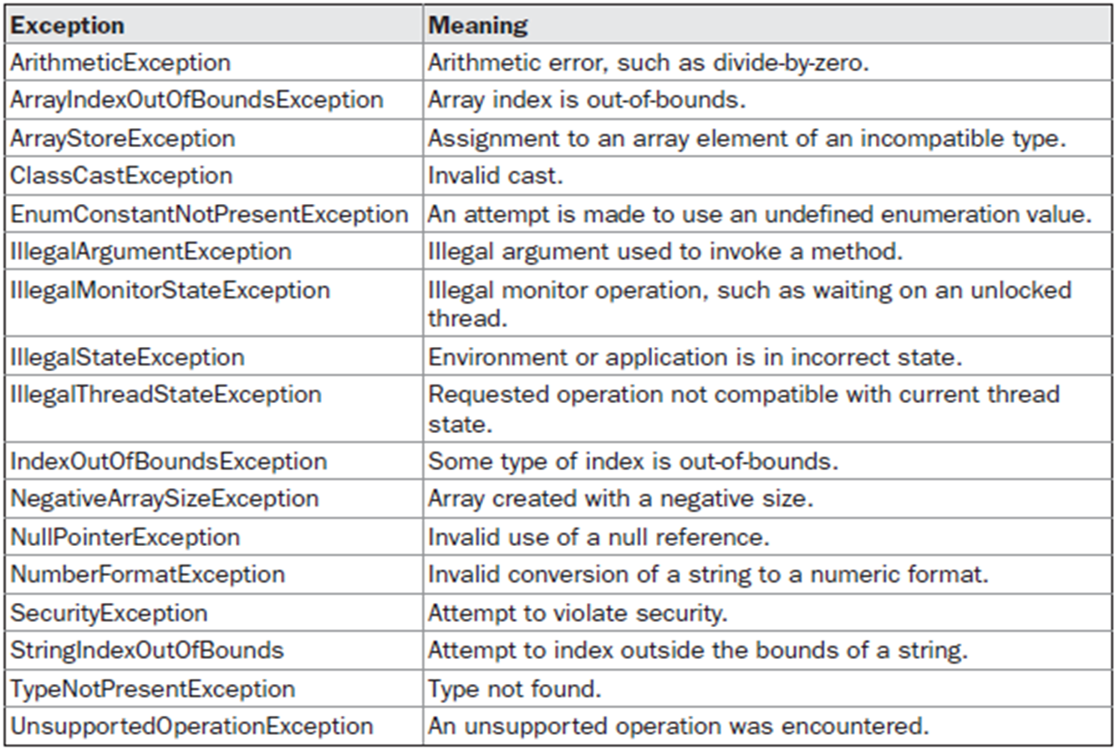
Java’s Unchecked RuntimeException Subclasses Defined in java.lang

Slide 37
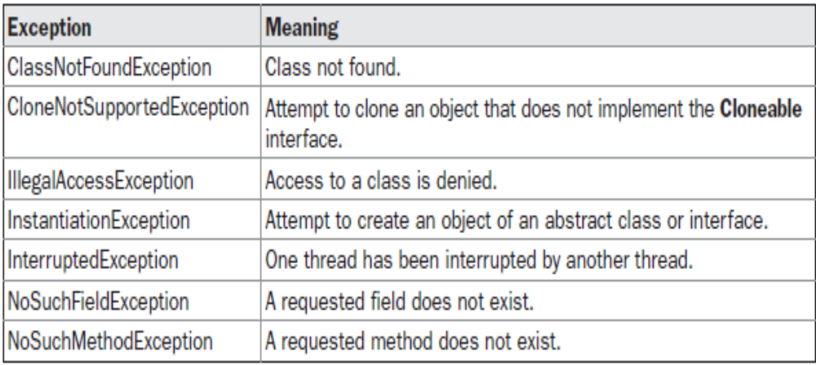
Java’s Checked Exceptions Defined in java.lang

Slide 38
Defining Custom Exceptions
We can create our own Exception sub-classes by inheriting Exception class.
The Exception class does not define any methods of its own.
It inherits those methods provided by Throwable.
Thus, all exceptions, including those that we create, have the methods defined by Throwable available to them.

Slide 39
Constructor for creating Exception
Exception( )
Exception(String msg)
A custom exception class is represented by a subclass of Exception / Throwable.
It contains the above mentioned constructor to initialize custom exception object.

Slide 40
Creating Own Exception Subclasses
class MyException extends Exception
{
private int detail;
MyException(int a) {
detail = a;
}
public String toString() {
return "MyException[" + detail + "]";
}
}
class ExceptionDemo {
static void compute(int a) throws MyException {
System.out.println("Called compute(" + a + ")");
if(a > 10)
throw new MyException(a);
System.out.println("Normal exit");
}
public static void main(String args[]) {
try {
compute(1);
compute(20);
} catch (MyException e) { System.out.println("Caught " + e); }
}
}

Slide 41
import java.util.*;
class NegativeCircleRadiusException extends Exception
{
public String toString()
{
return "Radius of Circle cannot be nagative";
}
}
class Circle
{ double radius;
Circle(double r)
{ radius=r;
}
double area() throws NegativeCircleRadiusException
{
if(radius<0.0)
{
throw new NegativeCircleRadiusException();
}
else
return 3.14*radius*radius;
}
}

Slide 42
class TestNegativeRadius
{
public static void main(String[] args)
{
Scanner sc= new Scanner(System.in);
System.out.println("Enter Radius of Circle");
double x=sc.nextDouble();
Circle c1=new Circle(x);
try
{
double d=c1.area();
System.out.println("Area of Circle is"+d);
}
catch(NegativeCircleRadiusException e)
{
System.out.println(e);
}
}
}

Slide 43
(NumberFormatException) Write a program that prompts the user to read two integers and displays their sum. Your program should prompt the user to read the number again if the input is incorrect .
Write a program that prompts the user to read radius of circle and display the area of circle if radius given by user is positive otherwise throw NegativeCircleRadiusException.

Slide 44
(IllegalTriangleException) Exercise defined the Triangle class with three sides. In a triangle, the sum of any two sides is greater than the other side. The Triangle class must adhere to this rule. Create the IllegalTriangleException class, and modify the constructor of the Triangle class to throw an IllegalTriangleException object if a triangle is created with sides that violate.
the rule, as follows:
/** Construct a triangle with the specified sides */
public Triangle(double side1, double side2, double side3)
throws IllegalTriangleException {
// Implement it
}

Slide 45
Assertions

Slide 46
An assertion is a statement in the Java programming language that enables you to test your assumptions about your program.
For example, you might have a method that should always return a positive integer value.
You might test this by asserting that the return value is
greater than zero using an assert statement. At run time, if the condition is true, no other action takes place. However, if the condition is false, then an AssertionError is thrown.
An assertion uses assert keyword.

Slide 47
The assert keyword has two forms. The first is shown here:
assert condition;
where
condition is a boolean expression. When the system runs the assertion, it evaluates condition and if it is false throws an AssertionError with no detail message.
The second form of assert is shown here:
assert condition: expr;
where:
Condition is a boolean expression.
expr is an expression that has a value. (It cannot be an invocation of a method that is declared void.)
Use this version of the assert statement to provide a detail message for the AssertionError. The system passes the value of expr to the appropriate AssertionError constructor, which uses the string representation of the value as the error's detail message.

Slide 48
To enable assertion checking at run time, you must specify the -ea option. For example:
java -ea <Class Name>

Slide 49
// Demonstrate assert.
class AssertDemo
{
static int val = 3;
static int getnum()
{
return val--;
}
public static void main(String args[])
{
int n;
for(int i=0; i < 10; i++)
{
n = getnum();
assert n > 0; // will fail when n is 0
System.out.println("n is " + n);
}
}
}

Slide 50
// Demonstrate assert Second Form.
class AssertDemo
{
static int val = 3;
static int getnum()
{
return val--;
}
public static void main(String args[])
{
int n;
for(int i=0; i < 10; i++)
{
n = getnum();
assert n > 0 : "n is negative!"; // will fail when n is 0 with message
System.out.println("n is " + n);
}
}
}

